Slide 1
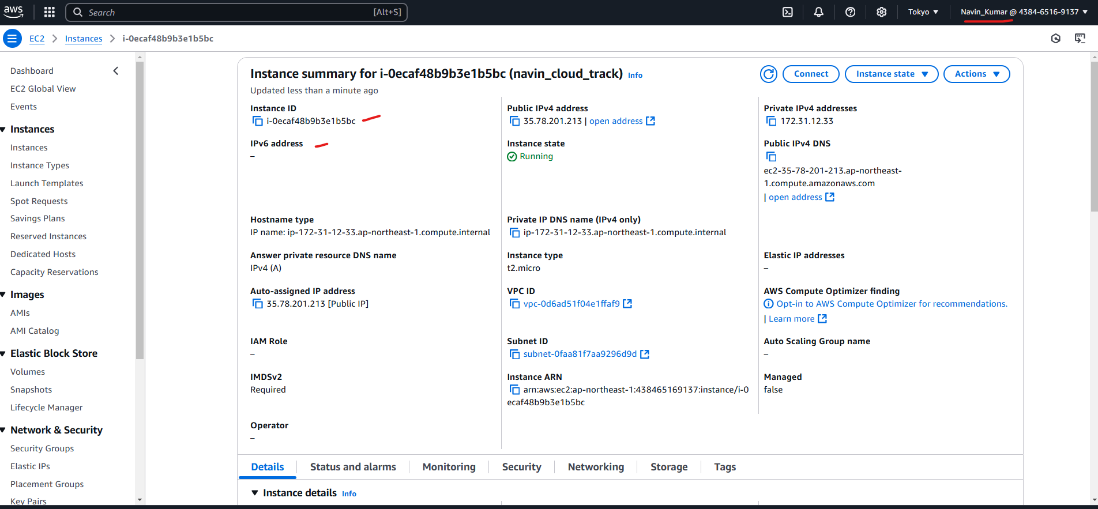
EC 2 instance created

Slide 2
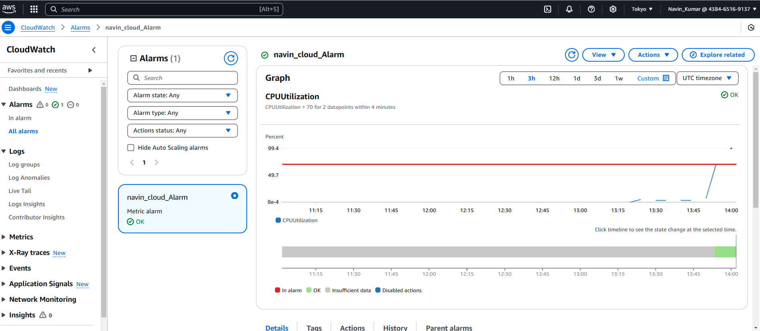
Cloud watch with ok

Slide 3
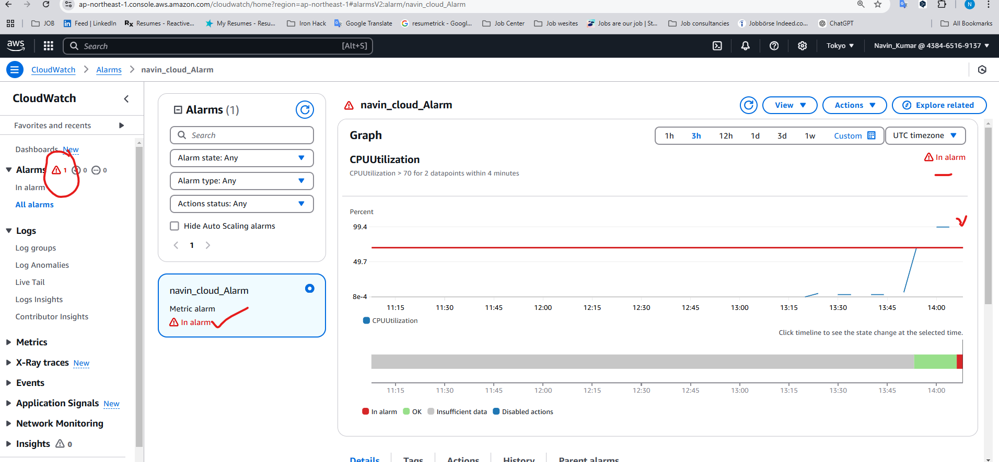
Cloud watch with Alarm

Slide 4
